Slide 1
Safeguarding supervision for Independent School Nurses Webinar
Introduction and Welcome - Sharon White OBE
Outline of safeguarding supervision proposed model – Mel Hayward
Group Discussion
Actions and close - Sharon White OBE

Slide 2
Sharon White OBE

Slide 3
Safeguarding Supervision for Independent School Nurses
What we are proposing – the Working Model
Associate Professor Melanie Hayward
RN (Child); SCPHN (SN); CPNP; RNT; FHEA; FRSA
(she, her, hers)
Twitter @melhayward

Slide 4
Safeguarding Supervision
Guidance Document
Context and proposed model of practice
Evidence based and experience informed
WHY
What
How
Where
When

Slide 5
The What
Definition
‘…accountable process where individuals are supported to explore, reflect critically and evaluate their own decisions and practice, identify and acknowledge the emotional impact of their work while receiving professional support, guidance, and development in a safe, protected environment’.
(HM Government, 2018 (updated 2022))

Slide 6
The What
Combines
Restorative Experience
Critical Thinking
Critical Reflection

Slide 7
The What
Safeguarding Supervision is | Safeguarding Supervision is not
A process | A meeting
Where general safeguarding practice will be explored and reflected on | The provision of general safeguarding advice
Where high-level safeguarding concerns that have been acted on can be explored and reflected on | An event to wait to share high-level safeguarding concerns
Owned by the supervisees, who are listened to, valued and heard | Mentoring by the facilitator
A safe place to share burdens | Therapy or counselling by the facilitator
Mutually supportive, inclusive and affirming | Judging individuals or their practice
Supportive of personal accountability | Blaming professionals or services
Open to questions and challenge | A place for gossiping or moaning

Slide 8
The How
Principles
Openness and Honesty
Equality Diversity and Inclusion
Confidentiality
Raising Concerns

Slide 9
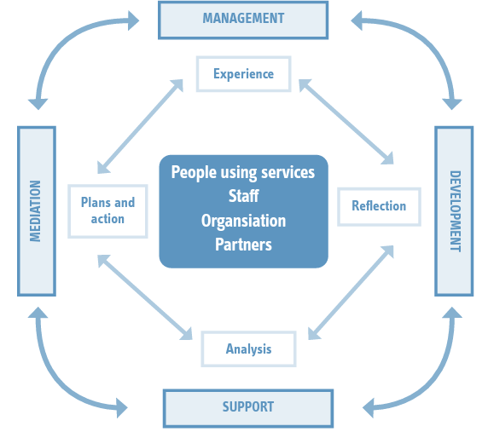
The How
Model
(Morrison, 2006)
Kolb (1984) and Wallbank and Wonnacott, (2015)

Slide 10
The How
Child Centred & Think Family
Contextual and Transitional
Inequalities
ACEs
Trauma Informed
Protective Factors
Strengths based
Context of Practice

Slide 11
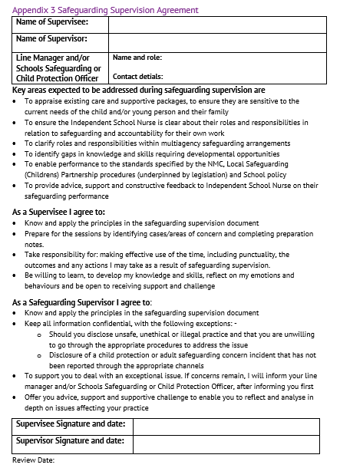
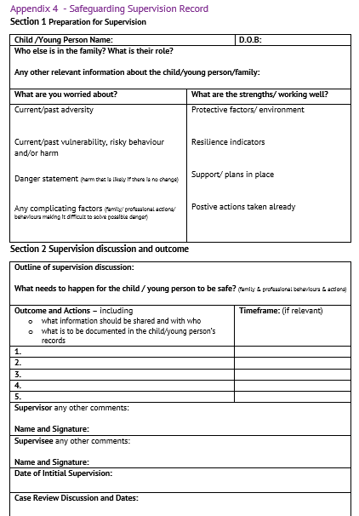
The How
Book Session
Preparation
Session
Documentation

Slide 12
The Where and When
Group
Geographical
Online
Four times a year
1 – 2 hours long

Slide 13
Questions and Discussion

Slide 14
Safeguarding supervision for Independent School Nurses
Sharon White OBE
Finally - Next Steps

Slide 15
This Photo by Unknown Author is licensed under CC BY-NC

